Slide 1




Inferential Statistics
Notes:
Good Morning everyone. Welcome to the session of Introduction to AIML
Today objective would be to know what is AIML, its imple-mentation along with type of models and its real life examples

Slide 2

My Journey
SDA Bocconi, Italy class of 2017 with Post Graduation in Analytics
Bachelor’s degree from NIT Surat, Schooling from K.V., where he was the house captain
10+ years of experience across L&T, Merck Pharmaceutical, OYO, Udaan & Zomato
Currently, Senior Manager at Zomato, working for Ads Monetization team
Notes:
A quick introduction about myself, I’m Shashank and I have 10+ yrs of work ex, I have worked with companies like L&T, merck, OYO, Udaan and currently working as a senior manager in Zomato. I passed out from NIT Surat in 2013 and I did post grad from SDA Bocconi in 2017

Slide 3





Notes:
Okay before we start Introduction to AIML session, can someone tell me what comes in your mind when you hear the word AIML.

Slide 4














Notes:
Okay before we start Introduction to AIML session, can someone tell me what comes in your mind when you hear the word AIML.

Slide 5













Notes:
Okay before we start Introduction to AIML session, can someone tell me what comes in your mind when you hear the word AIML.

Slide 6











Notes:
Okay before we start Introduction to AIML session, can someone tell me what comes in your mind when you hear the word AIML.

Slide 7











Notes:
Okay before we start Introduction to AIML session, can someone tell me what comes in your mind when you hear the word AIML.

Slide 8























Notes:
Okay before we start Introduction to AIML session, can someone tell me what comes in your mind when you hear the word AIML.

Slide 9















Notes:
Okay before we start Introduction to AIML session, can someone tell me what comes in your mind when you hear the word AIML.

Slide 10











Notes:
Okay before we start Introduction to AIML session, can someone tell me what comes in your mind when you hear the word AIML.

Slide 11














Notes:
Okay before we start Introduction to AIML session, can someone tell me what comes in your mind when you hear the word AIML.

Slide 12




































Notes:
Okay before we start Introduction to AIML session, can someone tell me what comes in your mind when you hear the word AIML.

Slide 13




























Notes:
Okay before we start Introduction to AIML session, can someone tell me what comes in your mind when you hear the word AIML.

Slide 14

















Notes:
Okay before we start Introduction to AIML session, can someone tell me what comes in your mind when you hear the word AIML.

Slide 15



Notes:
Okay before we start Introduction to AIML session, can someone tell me what comes in your mind when you hear the word AIML.

Slide 16










Notes:
Okay before we start Introduction to AIML session, can someone tell me what comes in your mind when you hear the word AIML.

Slide 17









Notes:
Okay before we start Introduction to AIML session, can someone tell me what comes in your mind when you hear the word AIML.

Slide 18





Notes:
Okay before we start Introduction to AIML session, can someone tell me what comes in your mind when you hear the word AIML.

Slide 19


































Notes:
Okay before we start Introduction to AIML session, can someone tell me what comes in your mind when you hear the word AIML.

Slide 20
































Notes:
Okay before we start Introduction to AIML session, can someone tell me what comes in your mind when you hear the word AIML.

Slide 21












Notes:
Okay before we start Introduction to AIML session, can someone tell me what comes in your mind when you hear the word AIML.

Slide 22
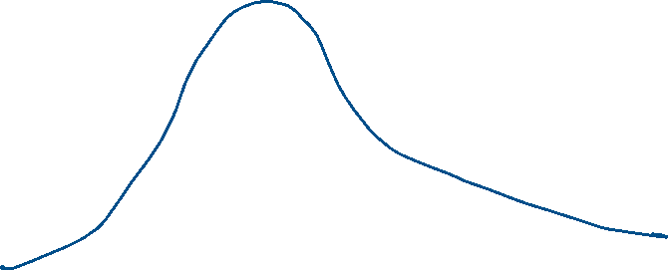
Notes:
Okay before we start Introduction to AIML session, can someone tell me what comes in your mind when you hear the word AIML.

Slide 23



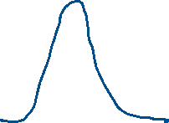










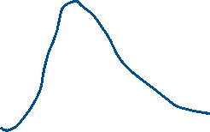





Notes:
Okay before we start Introduction to AIML session, can someone tell me what comes in your mind when you hear the word AIML.

Slide 24
Notes:
Okay before we start Introduction to AIML session, can someone tell me what comes in your mind when you hear the word AIML.

Slide 25
Notes:
Okay before we start Introduction to AIML session, can someone tell me what comes in your mind when you hear the word AIML.

Slide 26
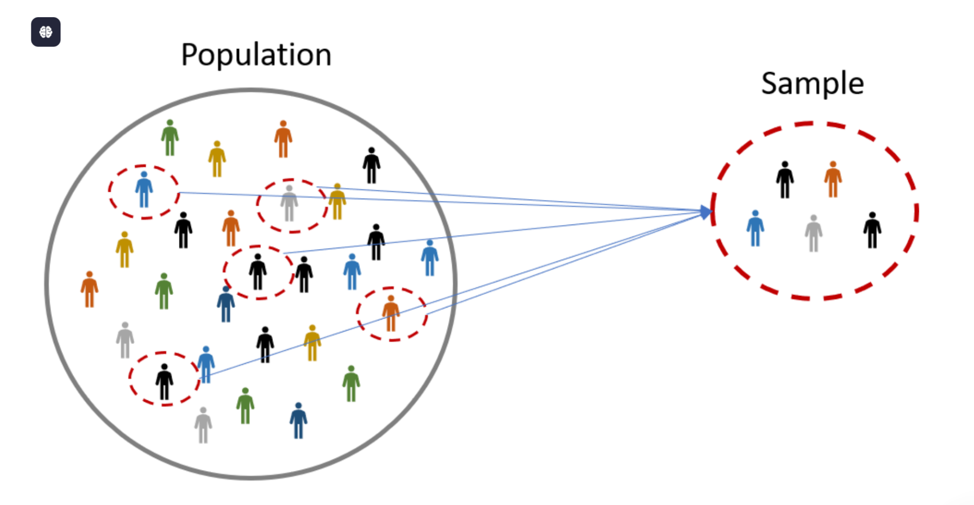









Notes:
Okay before we start Introduction to AIML session, can someone tell me what comes in your mind when you hear the word AIML.

Slide 27


Q. What is the main purpose of inferential statistics?
To summarize sample data
To make predictions about a population based on a sample
To organize raw data
To calculate probabilities in sample data
Notes:
Okay before we start Introduction to AIML session, can someone tell me what comes in your mind when you hear the word AIML.

Slide 28







Q. What happens to the width of a confidence interval if the sample size increases?
The width increases
The width decreases
The width stays the same
It becomes unpredictable
Notes:
Okay before we start Introduction to AIML session, can someone tell me what comes in your mind when you hear the word AIML.

Slide 29





Q. Which of the following is an example of selection bias?
Using a large random sample
Surveying only people who attend high-end restaurants to estimate national food preferences
Taking samples from different population strata
Randomly selecting customers from a database
Notes:
Okay before we start Introduction to AIML session, can someone tell me what comes in your mind when you hear the word AIML.

Slide 30









Q. Why is a representative sample important in inferential statistics?
It reduces data collection costs
It ensures valid and reliable conclusions
It eliminates the need for hypothesis testing
It avoids the need for data analysis
Notes:
Okay before we start Introduction to AIML session, can someone tell me what comes in your mind when you hear the word AIML.

Slide 31













Q. Which of the following is an example of point estimation?
Calculating a range for possible travel times
Predicting travel time as exactly 30 minutes
Stating that travel time will be between 25-35 minutes
Taking data from multiple samples for analysis
Notes:
Okay before we start Introduction to AIML session, can someone tell me what comes in your mind when you hear the word AIML.

Slide 32
















Q. In stratified sampling, the population is divided based on:
Random selection
Predefined characteristics or subgroups
Convenience of data collection
Equal intervals
Notes:
Okay before we start Introduction to AIML session, can someone tell me what comes in your mind when you hear the word AIML.

Slide 33































Q. What type of bias occurs when certain groups are left out of the sample?
Exclusion bias
Undercover bias
Sampling bias
Survivorship bias
Notes:
Okay before we start Introduction to AIML session, can someone tell me what comes in your mind when you hear the word AIML.

Slide 34


Q. What is survivorship bias?
Focusing on all data points equally
Ignoring failed or missing cases in data
Taking random samples from all groups
Using only recent data for analysis
Notes:
Okay before we start Introduction to AIML session, can someone tell me what comes in your mind when you hear the word AIML.

Slide 35

















Q. What is a key reason to use sampling instead of analyzing the entire population?
Increases data accuracy
Reduces data collection costs and time
Ensures bias-free results
Avoids data analysis errors
Notes:
Okay before we start Introduction to AIML session, can someone tell me what comes in your mind when you hear the word AIML.

Slide 36





Q. What is a point estimate in statistics?
A range of values used to estimate a population parameter
A single value used to estimate a population parameter
A hypothesis test
None of the above
Notes:
Okay before we start Introduction to AIML session, can someone tell me what comes in your mind when you hear the word AIML.

Slide 37















Q. What does the Central Limit Theorem state?
Sample data will always be normally distributed
The sample mean will approximate the population mean as the sample size increases
The population mean will always equal the sample mean
None of the above
Notes:
Okay before we start Introduction to AIML session, can someone tell me what comes in your mind when you hear the word AIML.

Slide 38










Q. Which sampling method ensures every individual has an equal chance of being selected?
Stratified sampling
Cluster sampling
Systematic sampling
Simple random sampling
Notes:
Okay before we start Introduction to AIML session, can someone tell me what comes in your mind when you hear the word AIML.

Slide 39

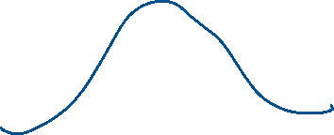







Q. If a 95% confidence interval for a population mean is (20, 30), what does it mean?
The population mean is 25
95% of the population falls between 20 and 30
We are 95% confident that the population mean lies between 20 and 30
The sample mean is between 20 and 30
Notes:
Okay before we start Introduction to AIML session, can someone tell me what comes in your mind when you hear the word AIML.

